Slide 1
Delaying the Future
Speaker: Raïssa Nataf
Technion
Nataf and Moses, DISC’24
DISC’25

Slide 2
Delaying the Future
Enables to modify the order of operations with no one noticing.
Impacts how objects must be implemented.
Is a unified approach for different models.

Slide 3
The Order of Operations Matters
Registers: A read must return the last written value.
Stack: A pop must return and remove the last pushed value.
Queue: A dequeue must return and remove the oldest element in the queue.
Every linearizable implementation of such objects must address this ordering matter.
…

Slide 4







Linearizability (informal)
Each operation appears to occur instantaneously in a way that is consistent with the real time order of events in the execution, and the sequential specification of the object.
$$W_{1}\left(a\right)$$
$$i$$
$$W_{2}(b)$$
$$j$$
$$R→b$$
$$R→$$
$$k$$

Slide 5
Linearizability (informal)
Each operation appears to occur instantaneously in a way that is consistent with the real time order of events in the execution, and the sequential specification of the object.
$$W_{1}\left(a\right)$$
$$i$$
$$W_{2}(b)$$
$$j$$
$$R→b$$
$$R→$$
$$k$$

Slide 6


Linearizability (informal)
Each operation appears to occur instantaneously in a way that is consistent with the real time order of events in the execution, and the sequential specification of the object.
$$W_{1}\left(a\right)$$
$$i$$
In asynchronous models, no access to real time!
$$W_{2}(b)$$
$$j$$
$$R→a$$
$$R→$$
$$k$$

Slide 7





Delaying Events
Conditions for re-ordering events while no one notices.
When aren’t processes able to notice events are delayed?
$$i$$
$$j$$
$$W\left(2\right)$$
$$k$$
$$R→1$$
time

Slide 8
Intermediate Recap
Order between operations matters.
In asynchronous models, no access to real time.
Implementations must ensure relative order.
What’s required for that?
Our work: Unified approach for different models to answer this.

Slide 9










The Delaying the Future Approach (DtF)
$$r$$
$$\tilde{r}$$
$$i$$
$$i$$
$$j$$
$$j$$
$$W\left(2\right)$$
$$W\left(2\right)$$
$$k$$
$$k$$
$$R→1$$
$$R→1$$

Slide 10





Nodes in Asynchronous Message Passing
Set of processes $Π=\left\{i,j,…\right\}$
Nodes = $\left\{\left\langle i,t\right\rangle :i∈Π,t≥0\right\}$
$$⟨i,t⟩$$
$$i$$
$$⟨j,t^{′}⟩$$
$$j$$

Slide 11







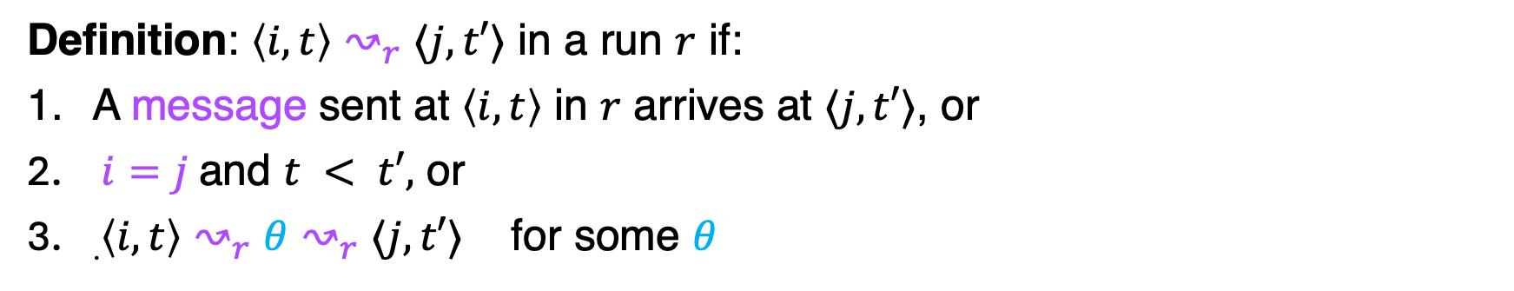

Lamport’s Happens-before (Message Chains)
Definition: $\left\langle i,t\right\rangle ↝_{r}$ $⟨j,t′⟩$ in a run $r$ if:
A message sent at $\left\langle i,t\right\rangle$ in $r$ arrives at $⟨j,t′⟩$, or
$i=j$and $t < t′,$ or
.$\left\langle i,t\right\rangle ↝_{r}$ $θ$ $↝_{r}⟨j,t′⟩$ for some $θ$
$$⟨i,t⟩$$
$$i$$
$$⟨j,t^{′}⟩$$
$$j$$
$$θ$$
$$k$$
$$l$$

Slide 12

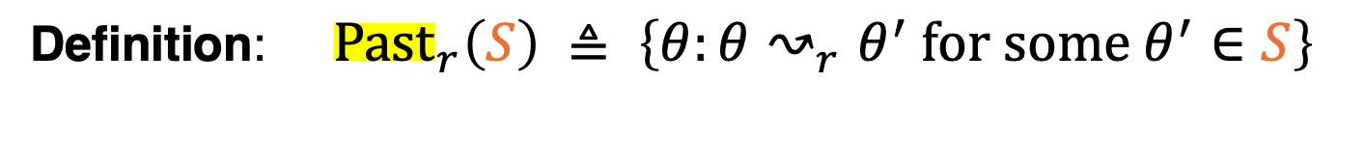



The Past of a Set of Nodes
Definition: ${Past}_{r}\left(S\right) ≜ \left\{θ:θ↝_{r}θ^{′} \text{for} \text{some} θ^{′}∈S\right\}$
$$S$$
$$i$$
$$j$$
$$k$$

Slide 13














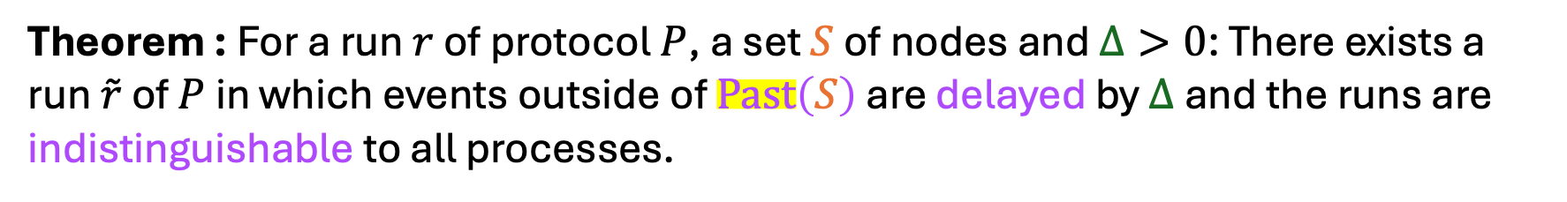




Delaying the Future Theorem
Theorem : For a run $r$ of protocol $P$, a set $S$ of nodes and $Δ>0$: There exists a run $\tilde{r}$ of $P$ in which events outside of $Past\left(S\right)$ are delayed by $Δ$and the runs are indistinguishable to all processes.
$$r$$
$$\tilde{r}$$
$$Δ$$
$$i$$
$$i$$
$$μ_{0}$$
$$S$$
$$μ_{2}$$
$$μ_{0}$$
$$S$$
$$Δ$$
$$μ_{2}$$
$$j$$
$$j$$
$$μ_{1}$$
$$μ_{1}$$
$$k$$
$$Δ$$
$$k$$

Slide 14



DtF Implies Necessity of Message Chains for Linearizable Registers
$$W\left(a\right)$$
$$R→a$$
$$i$$
$$W(b)$$
$$j$$

Slide 15
DtF Implies Necessity of Message Chains for Linearizable Registers
$$W\left(a\right)$$
$$R→a$$
$$i$$
$$W(b)$$
$$j$$

Slide 16




DtF Implies Necessity of Message Chains - 2
$$W\left(a\right)$$
$$i$$
$$W\left(b\right)$$
$$j$$
$$R→b$$
$$k$$

Slide 17
DtF Implies Message Chains Necessity - 2
$$W\left(a\right)$$
$$i$$
$$W\left(b\right)$$
$$j$$
$$R→b$$
$$k$$

Slide 18
TSO (Total Store Order) - Weak Memory
Relaxing traditional Strictly Consistent Memory (SCM) for efficiency by delaying propagation of writes.
Widely used in modern hardware architectures like Intel’s x86 and Intel’s x64.
Counterintuitive behaviors → Synchronization primitives are used.
[Castañeda et al, DISC’24],[ Attiya et al POPL’11]

Slide 19










The TSO Model
$$x$$
$$3$$
$$4$$
$$1$$
Shared Memory
Write_{x}(1)
$$i$$
Propagate(1)
$$d_{i}$$
Write_{x}(3)
Read(x)→(3)
Fence
$$j$$
Propagate(3)
$$d_{j}$$
Read(x)→(1)
RMW_{x}(3,4)
$$k$$
Fences/RMWs are costly
$$d_{k}$$

Slide 20








Nodes in TSO executions
Set of processes $Π=\left\{i,j,…\right\}$
For each process $i$, its “dispatcher” $d_{i}$.
$Ag=Π∪{\left\{d_{i}\right\}}_{i∈Π}$
Nodes = $\left\{\left\langle b,t\right\rangle :b∈Ag,t≥0\right\}$
$$⟨i,t⟩$$
$$i$$
$$⟨d_{i},t^{′′}⟩$$
$$d_{i}$$
$$⟨j,t^{′}⟩$$
$$j$$
$$d_{j}$$

Slide 21
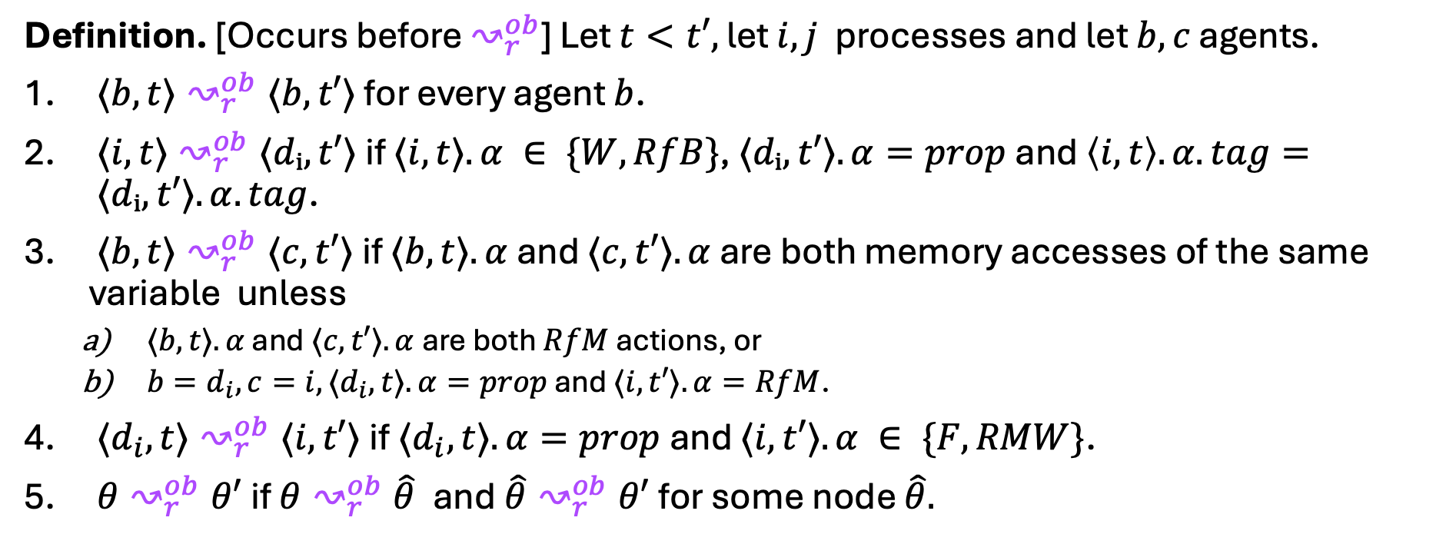
Occurs-before Relation in TSO
Definition. [Occurs before $↝_{r}^{ob}$] Let $t<t′,$ let $i,j$ processes and let $b,c$ agents.
$⟨b,t⟩↝_{r}^{ob}⟨b,t′⟩$ for every agent $b$.
$⟨i,t⟩↝_{r}^{ob}⟨dᵢ,t′⟩$if $⟨i,t⟩.α ∈ \{W,RfB\}$, $⟨dᵢ,t′⟩.α=prop$and $\left\langle i,t\right\rangle .α.tag= ⟨dᵢ,t′⟩.α.tag$.
$⟨b,t⟩↝_{r}^{ob}⟨c,t′⟩$if $⟨b,t⟩.α$ and $⟨c,t′⟩.α$ are both memory accesses of the same variable unless
$⟨b,t⟩.α$ and $⟨c,t′⟩.α$are both $RfM$ actions, or
$b=d_{i}, c=i, ⟨d_{i},t⟩.α=prop$ and $⟨i,t′⟩.α=RfM$.
$⟨d_{i},t⟩↝_{r}^{ob}⟨i,t′⟩$if $⟨d_{i},t⟩.α=prop$and $⟨i,t′⟩.α ∈ \{F,RMW\}$.
$θ↝_{r}^{ob}θ′$if $θ↝_{r}^{ob}\hat{θ}$and$\hat{θ}↝_{r}^{ob}θ′$for some node $\hat{θ}.$
“Happens-before” relation in TSO [Alglave et. al, CAV’10], [Bouajjani et. al CAV’18]

Slide 22



Occurs-before Relation in TSO
Write_{x}(1)
$$i$$
Propagate(1)
$$d_{i}$$
Write_{x}(3)
Read(x)→3
Fence
$$j$$
Propagate(3)
$$d_{j}$$
Read(x)→1
RMW_{x}(3,4)
$$k$$
$$d_{k}$$

Slide 23





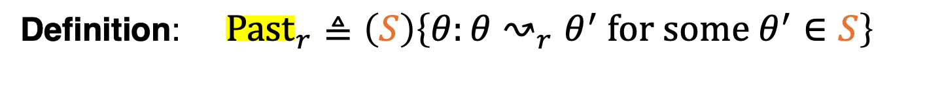


The Past of a Set of Nodes in TSO
Definition: ${Past}_{r}≜\left(S\right)\left\{θ:θ↝_{r}θ^{′} \text{for} \text{some} θ^{′}∈S\right\}$
$$S$$
$$i$$
$$d_{i}$$
$$j$$
$$d_{j}$$
$$k$$
$$d_{k}$$

Slide 24
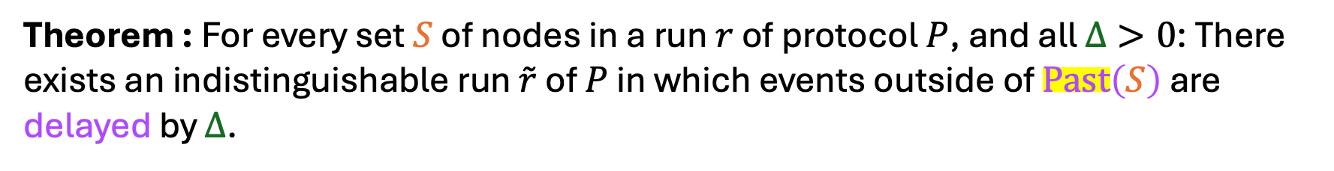













Delaying the Future in TSO
Theorem : For every set $S$ of nodes in a run $r$ of protocol $P$, and all $Δ>0$: There exists an indistinguishable run $\tilde{r}$ of $P$ in which events outside of $Past\left(S\right)$ are delayed by $Δ$.
$$r$$
$$\tilde{r}$$
$$S$$
$$S$$
$$Δ$$
$$i$$
$$i$$
$$d_{i}$$
$$d_{i}$$
$$j$$
$$j$$
$$W\left(2\right)$$
$$W\left(2\right)$$
$$d_{j}$$
$$d_{j}$$
$$k$$
$$k$$
$$R→1$$
$$R→1$$
$$d_{k}$$
$$d_{k}$$

Slide 25




Intermediate Recap
Async Message Passing
Happens-before relation
TSO (Weak Memory)
Occurs-before relation
Delaying the Future Theorem:
$$Δ$$
$$i$$
$$i$$
$$Δ$$
$$j$$
$$j$$
$$k$$
$$Δ$$
$$k$$

Slide 26





Current work: Commutativity
Definition: Operations $o_{1},o_{2}∈\text{Ops}\text{(}O\text{)}$ commute if: For all operations $o_{3}∈\text{Ops}\text{(}O\text{)}$ and response values $u_{1},u_{2},u_{3}$,
$\left[o_{1}u_{1}\right]⋅\left[o_{2}u_{2}\right]⋅\left[o_{3}u_{3}\right]∈\text{Spec}\text{(}O\text{)}$ if and only if
$\left[o_{2}u_{2}\right]⋅\left[o_{1}u_{1}\right]⋅\left[o_{3}u_{3}\right]∈\text{Spec}\text{(}O\text{)}$.
Commute
Do not commute
$$R→a , R→a$$
$$R→a,W\left(b\right)$$
$$W\left(a\right),W\left(a\right)$$
$W\left(a\right)$ $, W\left(b\right)$
new

Slide 27
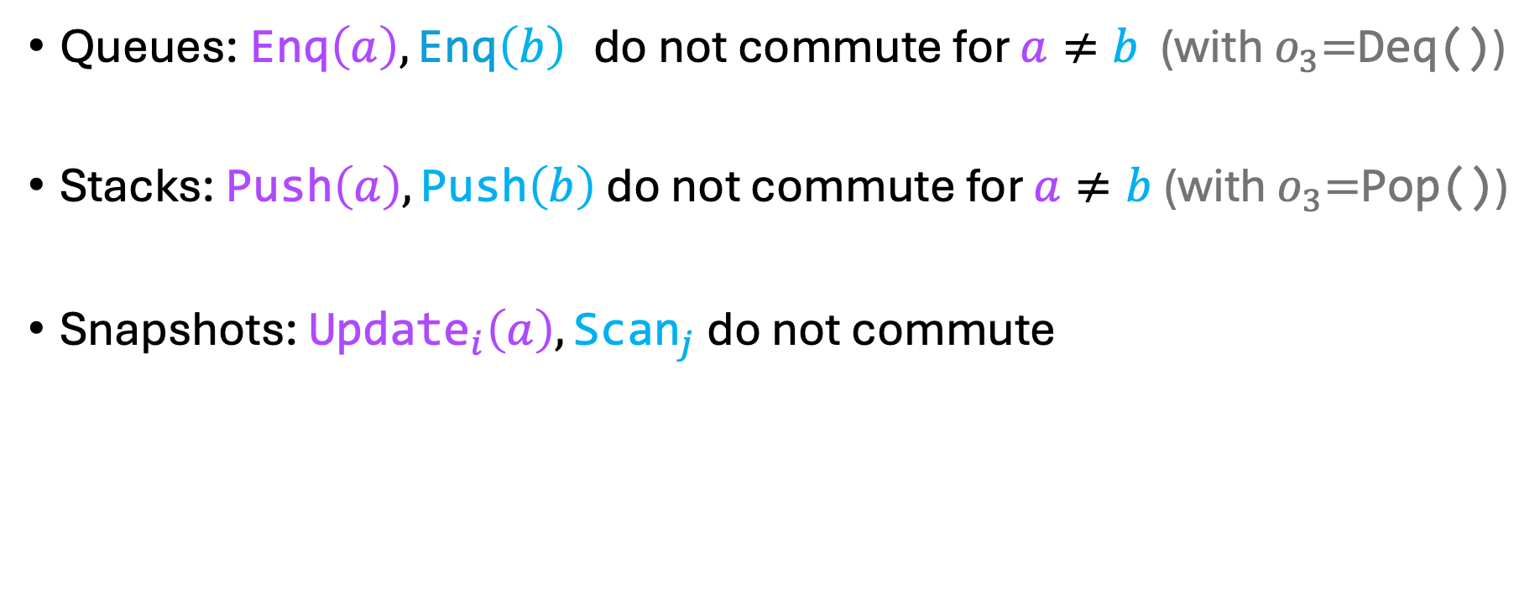
Non-commutativity for Other Objects
Queues: $\text{E}\text{nq}\left(a\right),\text{Enq}\left(b\right)$ do not commute for $a≠b$ (with $o_{3}\text{=}\text{Deq}\text{()}$)
Stacks: $\text{Push}\left(a\right), \text{Push}\left(b\right)$ do not commute for $a≠b$ (with $o_{3}\text{=}\text{Pop}\text{()}$)
Snapshots: ${\text{U}\text{pdate}}_{i}\left(a\right), {\text{Scan}}_{j}$ do not commute

Slide 28







Non-commutativity Demands Happens-before
Theorem: In a linearizable implementation of an object $O,$ if $o_{1},o_{2}∈\text{Ops}\text{(}O\text{)}$ are non-commutative, then every run $r=o_{1}⋅ o_{2}⋅…$ must contain a chain $o_{1}↝_{r}o_{2}$.
True also in TSO
$$o_{1}$$
$$u_{1}$$
$$i$$
$$j$$
$$o_{2}$$
$$u_{2}$$

Slide 29




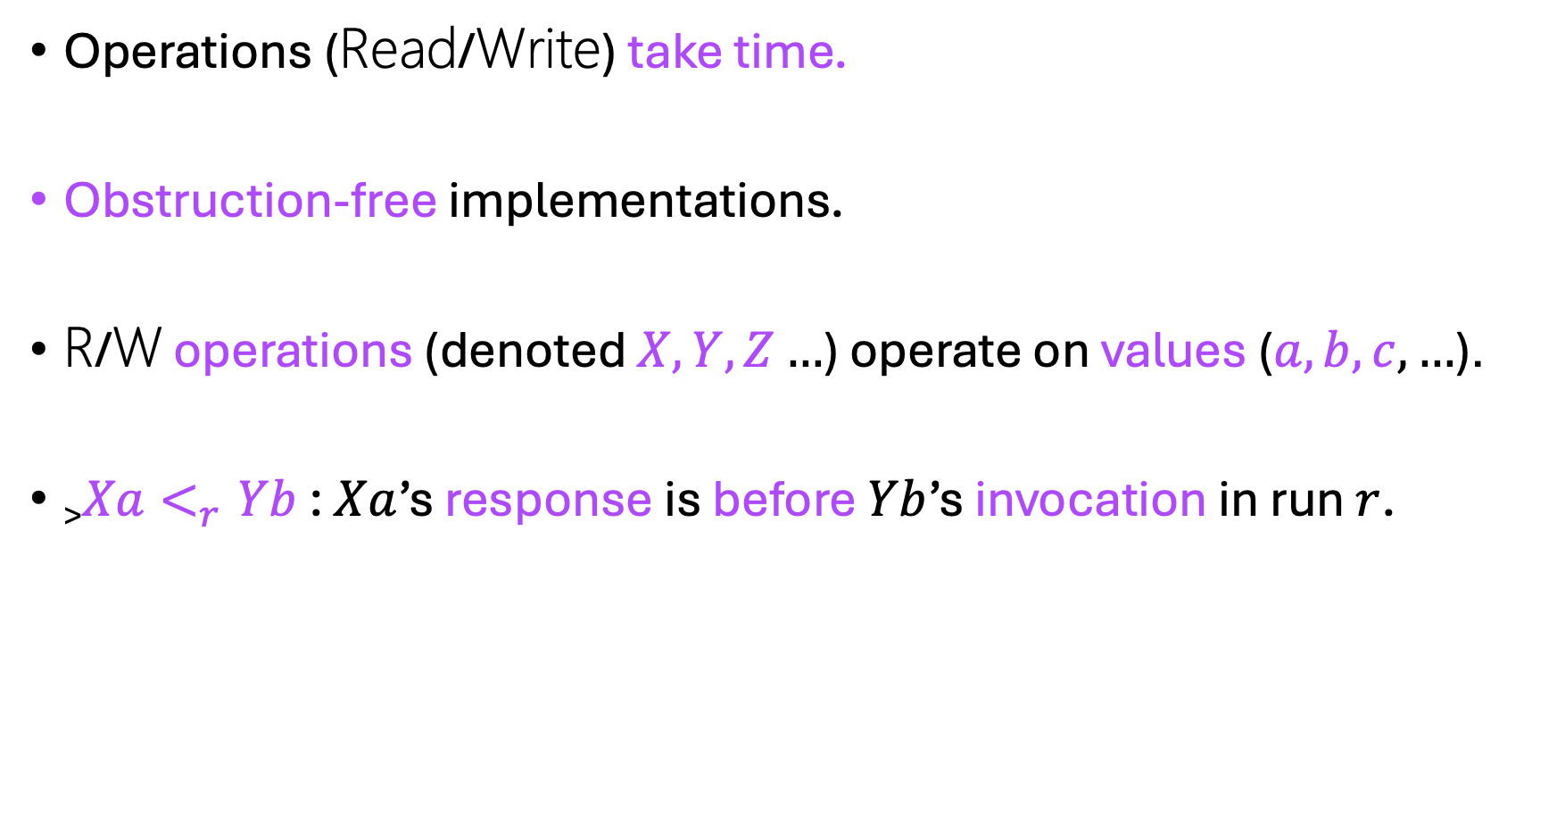

Linearizable Implementations of Registers
$$j$$
Operations (Read/Write) take time.
Obstruction-free implementations.
R/W operations (denoted $X,Y,Z…$) operate on values ($a,b,c,…$).
>$Xa<_{r}Yb$ : $Xa$’s response is before $Yb$’s invocation in run $r$.
$$k$$
$$p$$
$$inv$$
$$resp$$
time

Slide 30



















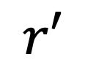


Linearizability Entails Chains
Theorem: Let $Xa<_{r}Yb$ and assume that $Yb$ completes in $r$. If $Yb$ runs in isolation in $r$ and $a≠b$, then $Xa↝_{r}Yb$.
$$W\left(a\right)$$
$$W\left(b\right)$$
$$r$$
$$r′$$
$$R→b$$
$$\tilde{r}$$
Violation
$$Xa$$
$$Xa$$
$$Xa$$
$$Δ$$
$$i$$
$$Yb$$
$$Yb$$
$$Yb$$
$$j$$
$$θ$$
$$θ$$
$$R→ ?$$
$$Δ$$
$$R→b$$
$$R→b$$
$$k$$

Slide 31












Implications
Applies to every execution – Best case lower bound
Every register implementation must construct chains between operations of all types.
$$W\left(a\right)$$
$$R→a$$
$$i$$
$$i$$
$$W\left(b\right)$$
$$W\left(b\right)$$
$$j$$
$$j$$
$$R→a$$
$$W\left(a\right)$$
$$i$$
$$i$$
$$R→b$$
$$R→b$$
$$j$$
$$j$$

Slide 32





Implications in Message Passing, up to $f$ crashes
Corollary: Every completing operation must have round trip interactions with a quorum of at least $f$ other processes.
$$i$$
$$f=2$$
$$j$$
$$k$$
$$Xa$$
$$p$$

Slide 33





Implications in Message Passing, up to $f$ crashes
Corollary: Every completing operation must have round trip interactions with a quorum of at least $f$ other processes.
$$k$$
$$p$$
$$Yb$$
$$i$$
$$f=2$$
$$j$$
$$k$$
Contradicting our theorem
$$Xa$$
$$p$$

Slide 34
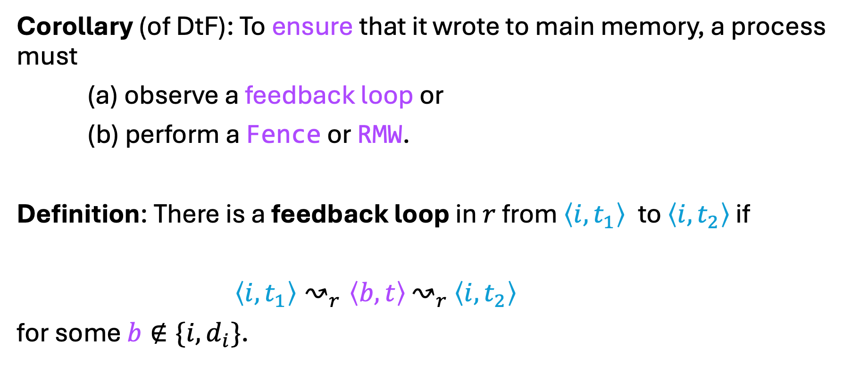
Implications in TSO, Fences and Feedback Loops
Corollary (of DtF): To ensure that it wrote to main memory, a process must
(a) observe a feedback loop or
(b) perform a Fence or RMW.
Definition: There is a feedback loop in $r$ from $\left\langle i,t_{1}\right\rangle$to $\left\langle i,t_{2}\right\rangle$ if
$\left\langle i,t_{1}\right\rangle ↝_{r}\left\langle b,t\right\rangle$ $↝_{r}$ $\left\langle i,t_{2}\right\rangle$
for some $b∉\{i,d_{i}\}$.

Slide 35
Conclusion
DtF captures when we can modify the order of events with no one noticing.
DtF is a unified approach for different models. Based on:
Happens-before in Async message passing.
Occurs-before in TSO.
DtF enables deriving lower bounds on linearizable implementations of objects.

Slide 36
Discussion
Thank you!
Alglave et al (CAV’10), Bouajjani et al (CAV’18) define happens-before for TSO. Their definitions do not admit a DtF theorem.
Lahav and Margalit (PLDI’19) define happens-before for Release/Acquire. Their definition appears to admit DtF.
Attiya et al (POPL’11), Castañeda et al (DISC’24) provided more restricted definitions of non-commutativity.
Extend approach to other models: e.g., Release Consistency (Gharachorloo ISCA’90).
Extend approach to other correctness properties: Strong linearizability and its variants.

