Slide 1
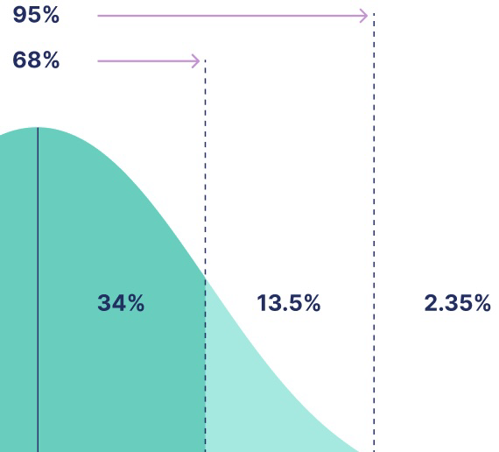
Stochastic certainty in decentralised systems: algorithms and verification
Bill Roscoe
TBTL and University College Oxford Blockchain Research Centre
Part of Reinventing the Blockchain
From Understanding Decentralised Systems Springer 2026
10⁻¹⁶%
1σ 2σ 8σ 9σ

Slide 2
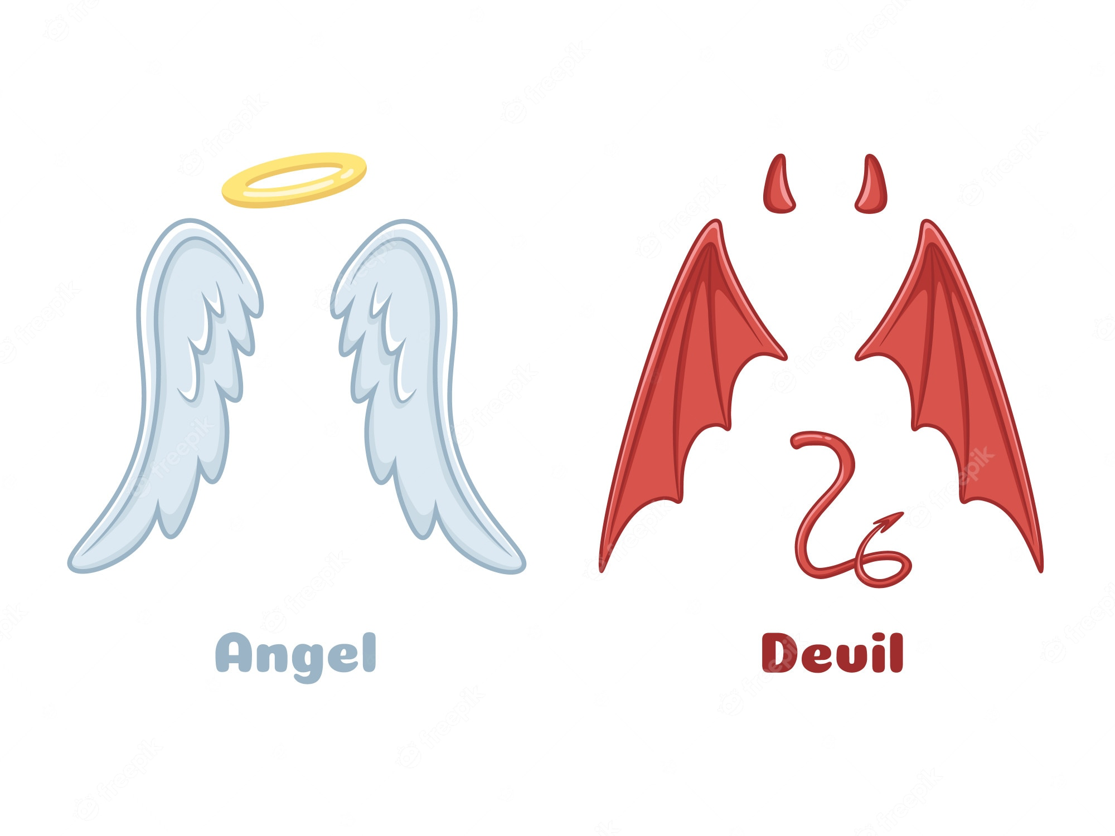
What do I mean by reinvent?
Build on the basic idea of a blockchain to create a more efficient and resilient structure
Building high integrity angelic behaviour around a decentralised community with demonic members.
Unafraid to throw away some well established ideas.
And embrace ideas not seen in the usual blockchain architectures.
I see blockchain as a model of concurrency.
My thesis: blockchains and decentralised systems should be able to take advantage when malicious behaviour is less than allowed for. SAFELY

Slide 3
Finding the right abstraction
We need to understand, construct and verify decentralised systems in the presence of assumed malevolence from a proportion of the agents.
It is common to assume that all agents are potentially malevolent/Byzantine, but with overall limits on how many.
This had me baffled for a long time, even though I had often modelled systems in which malevolence was contained in a particular part of the system, such as the intruder model in crypto protocols.
But then I discovered three techniques: stochastic proof, consensus machines, and the hand-over protocol.
And then my decentralised model mapped perfectly onto CSP and FDR. Indeed required them to justify abstractions.

Slide 4
Stochastic proof
Pick collections of agents — using an unbiassable random process — such that we know that a chosen proportion of them are good, with certainty so high that we are prepared to ignore the risk. Say ε =10⁻¹⁸.
Tolerance must be based on how many selections S will be made, so for example if 3 per block and < 1 billion blocks then S=3.10⁹. Need εS to be negligible.
Maybe at least 1 good agent, or 5 good, or 51% good, or 67% good.
Then simply assume this in analysis of behaviour.
Note that, usually, Byzantine agreement is just a special case of stochastic proof, as it is based on an assumption.

Slide 5
Stochastic certainty
So limits for stochastic certainty depend crucially on number of tests, so if one committee is selected for all time there is only one, but for Bitcoin hash puzzles there are about 2⁹⁵ per annum!
My central case is blockchain algorithms where O(1) test per block.
Often selecting committees.
Hence the example figure of 10⁻¹⁸.
We want to rely, for practical purposes, on things never going wrong.
We want to engineer probability so it delivers effective certainty.

Slide 6
Stochastic certainty in Byzantine Agreement
Byzantine agreement requires > 2/3 good
Since we do not deliberately pick bad agents, we cannot enforce this!
It is much more realistic to assume a probability of a random agent being good is > p.
But p=2/3 only makes it about 50% that 2/3 will be good. Central limit theorem.
We demand stochastic certainty, say at 10⁻⁹ level — as there is only one sample.
With this example p=3/4 means we need 333 to ensure 2/3 good in a population of 1000.
You need p=0.9 if population is 40.
Conclusions: assumptions about unknown populations are inherently stochastic and accurate analysis leads to unexpected conclusions.
This gives a precise mathematical demonstration that clustering is harmful!

Slide 7
Stochastic analysis everywhere!
Choose “committees” for individual algorithms via bullet-proof random beacons. Directly or indirectly —e.g. piggybacking on another choice.
Small committee — guaranteed to have a small constant good
Intermediate — guaranteed to have > ½ good
Large — guaranteed to have 2/3 good —as in Byzantine agreement.

Slide 8
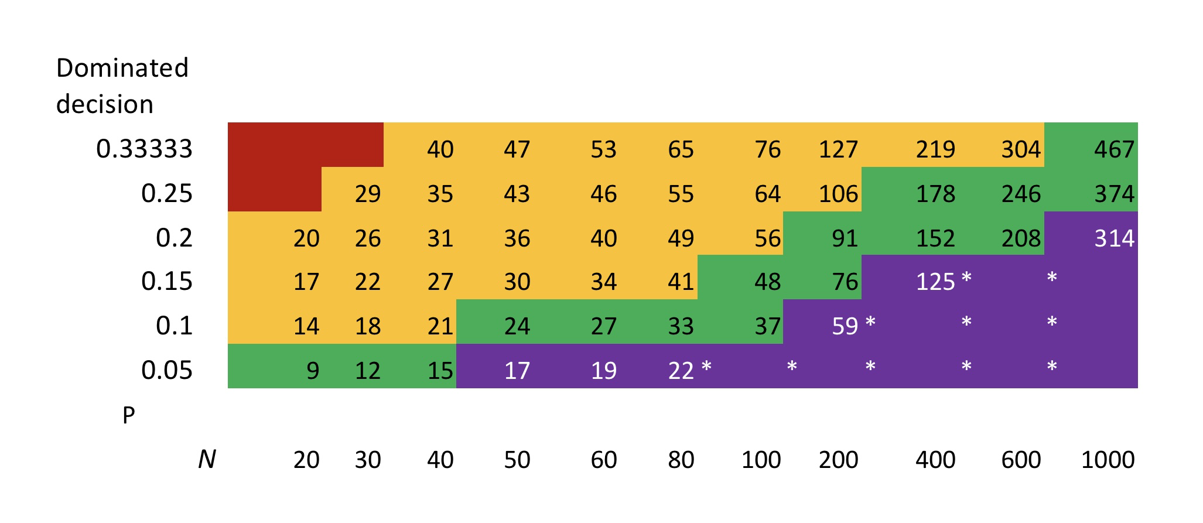
Combinatorics based on 10⁻¹⁸ tolerance
Smallest subset stochastically guaranteed to have at least one good member
Size of sample
Sample chosen fairly, subset chosen demonically

Slide 9
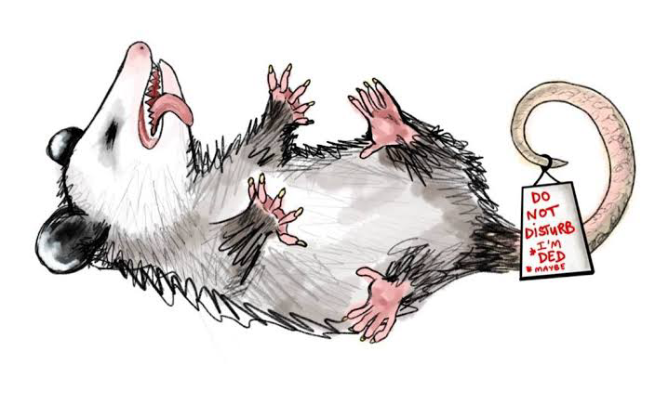
Why demonically?
After a committee has been nominated fairly, their actual participation can be affected by
Good agents doing the right thing or being delayed or being blocked
The same for bad agents or saying something wrong or playing possum
Which very much puts the ones that are seen in the hands of a demon controlling all the bad plus any nondeterminism in the network.
A wonderful instance of the classic concurrency issue of differentiating probabilistic and nondeterministic choice.

Slide 10

Examples
Hooks — links forward through blockchain — small with backup or intermediate.
Consensus in general —e.g. how may block creators needed to guarantee a good one — a small committee
2 level consensus (see Antoine’s talk) — primary small, secondary large or (depending on set-up) intermediate.
Random number beacon — several options.
Synchronising clocks
Coping with unreliable communication. E.g. in Handover

Slide 11
Interface with verification
We have:
Abstracted organised decentralised behaviour into Consensus machines
With communication by decentralised signals — two step reads and writes of shared variables.
Developed and proved the handover protocol as an asymmetric form of mutual exclusion
Tested decentralised committees satisfying the limits on bad behaviour.
Built small models of blockchains using innovative ways of modelling data storage.
All in CSP/FDR

Slide 12



Composing around deadlock
We want to compose a safe, efficient primary mechanism that can always deadlock
With a safe, inefficient but live backup mechanism
And produce a safe, live and usually efficient result.
Everything is decided in a decentralised form.
Allowing both primary and secondary to offer a decision looks highly problematic. Covert certificates are a particular issue.
At first sight this looks like a job fox Mutex.
But deadlock for Primary while it holds the mutex token would be a disaster.

Slide 13
Modelling in CSP — of course
We could choose to model the individual agents, including bad ones.
Or we can model the component consensus machines as sequential, with actions representing decision certificates.
Treat signals to other machines as slow writes to locations: the locations are distributed and there will be times when a reader may or may not see the value of an incomplete write.
In each decision, each location will be written at most once and the value is unambiguous.
Write starts once the machine decides to do it, and is complete before the next action.

Slide 14
In preparation
My new book Understanding Decentralised Systems: Foundations and Blockchain, Springer 2026.
With two more volumes planned.

